Slide 1


Building & Property Standards Commission
June 23, 2016
Presented By:
Alan D. Lathrom
Brown & Hofmeister, L.L.P.
740 E. Campbell Road, Suite 800
Richardson, Texas 75081
(214) 747-6108 FAX (214) 747-6111
alathrom@bhlaw.net

Slide 2
BPSC:
The Basics

Slide 3
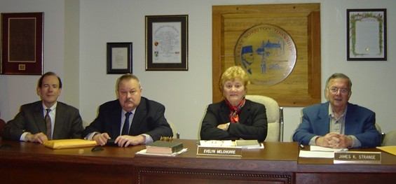
Introduction
The Texas Local Government Code provides for the creation of the Building & Property Standards Commission, a board with “quasi-judicial” authority, to address substandard building issues among other health and safety concerns.
Notes:
3

Slide 4
Authority and Jurisdiction
Sections 2-192 through 2-198 of the Farmersville Code of Ordinances provide for the creation, and duties and responsibilities, of the Building and Property Standards Commission.
Sections 14-301 through 14-313 of the Code set out the obligations of property owners and occupants to maintain their property as well as further details regarding the Building and Property Standards Commission.
The Commission’s authority and jurisdiction are derived from Chapters 54 and 214 of the Texas Local Government Code.
Notes:
4

Slide 5
The BPSC has authority to hear cases regarding:
The materials or methods used to construct a building or improvement, including the foundation, structural elements, electrical wiring or apparatus, plumbing and fixtures, entrances, or exits;
the fire safety of a building or improvement, including provisions relating to materials, types of construction or design, warning devices, sprinklers or other fire suppression devices, availability of water supply for extinguishing fires, or location, design, or width of entrances or exits;
Notes:
5

Slide 6

The BPSC has authority to hear cases regarding:
Dangerously damaged or deteriorated buildings or improvements;
A building code as it pertains to the condition, use, or appearance of property in the city; and
Accumulations of refuse, vegetation, or other matter that creates breeding and living places for insects and rodents.
Notes:
6

Slide 7
BUT . . .
The BPSC does NOT have any authority that conflicts with, or is duplicative of, the jurisdiction of any other City Board or Commission.

Slide 8
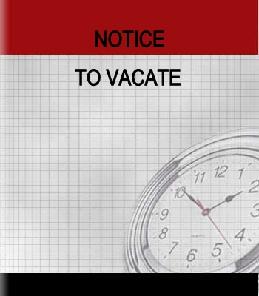
The BPSC has the power:
  to declare a building substandard;
  to require, within a specific time, the reduction of occupancy in an over-crowded structure and/or the vacation of a structure that is dangerous to the health, safety, or welfare of the occupants;
Notes:
8

Slide 9
The BPSC has the power:
  to order the immediate removal of persons found on private property in violation of an ordinance, and to enter onto that property to secure the removal if necessary;
  to require the removal and storage of property from a structure ordered vacated or demolished;
Notes:
9

Slide 10
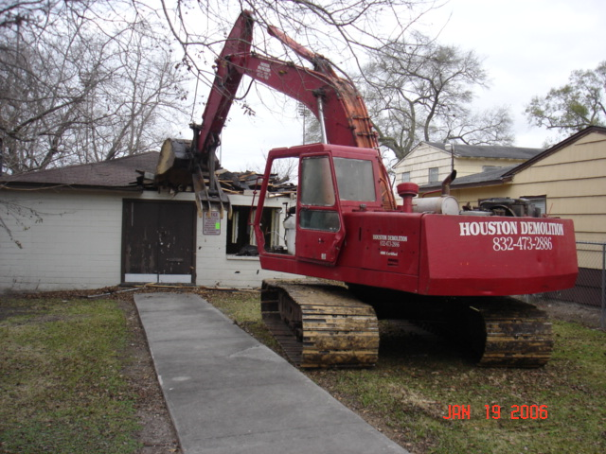
The BPSC has the power:
  to require the demolition, by the owner or by the City, of a structure found to be a public nuisance;
  to require, as an alternative to demolition, the repair of the structure by
  the owner or by the City
  found to be a public
  nuisance;
Notes:
10

Slide 11
The BPSC has the power:
  to require that the owner, lienholder or mortgagee of property repair a structure and bring same into compliance with current codes and applicable standards;
  to require the correction, by the owner, the City, or a private contractor, of a dangerous condition, as defined by City ordinance or State law, on the land; and
  to require that structures be secured against entry.
Notes:
11

Slide 12

The BPSC has the power:
To determine the amount and duration of the civil penalty, up to $1,000.00 per day, the City may recover against the person with control over the premises, in a suit for such purpose;
To grant variances when, in BSC’s opinion, a literal interpretation of the Housing and Substandard Building Code, the Housing Code and the Uniform Code for the Abatement of Dangerous Buildings, as adopted, would result in an unnecessary or unreasonable hardship, provided that the variance does not create or allow the existence of a hazardous condition; and

Slide 13
The BPSC has the power:
determine that the structure or complained of situation does not violate the subject Code provision under which a case is brought to the Commission.

Slide 14
Procedures Required to Demolish a Structure
CHAPTER 214, TEXAS LOCAL GOVERNMENT CODE, AND THE CITY’S ORDINANCE
Notes:
14

Slide 15
Notice and Hearing
Notes:
15

Slide 16
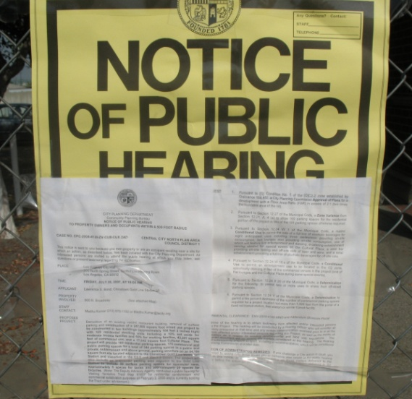
Notice
Identify the structure as substandard
Send a notice of public hearing to record owners, mortgagees, lienholders and each holder of a recorded lien against the affected property by U.S. Mail CMRRR.
Post the notice on the front door (or as close to the front as possible) of each improvement on the Property.
Notes:
16

Slide 17
Notice
If notice is returned undelivered, the building official may serve the notice personally if the person can be found in the county.
If owner cannot be located after diligent search, the building official notice shall be given by publication in the official newspaper of the city at least five days before the hearing.
Notes:
17

Slide 18

Notice
Must state date, time and place of hearing and be mailed and posted before the 10th day preceding the date of the hearing.
Must be published in a newspaper of general circulation in the City on one occasion before the 10th day preceding the hearing.
Notes:
18

Slide 19
Notice
Must contain:
  Identification of the building and the property on which it is located;
  Description of the violation of the applicable City standards;
  Statement that the city will vacate, secure, remove, repair, or demolish the building or relocate the occupants if the ordered action is not taken within a reasonable time.
Notes:
19

Slide 20
Procedure
Cases must be heard at a properly posted meeting that is open to the public.
Hear presentation of evidence and testimony by City regarding alleged violations of ordinances and the condition of the structure.
At each hearing the owner, lessor occupant or lienholder may present witnesses; and, is entitled to cross examine any witnesses appearing against him.
Notes:
20

Slide 21
Continuances may be granted if the BPSC finds . . .
The owner, lienholder or mortgagee has made reasonable efforts to obtain information and evidence for the hearing but requires additional time to secure said information; and
The property is secured from unlawful entry; and
A delay in the proceedings will not pose a threat or danger to the general health, safety and welfare of the citizens.

Slide 22
Continuances . . .
City staff may request a continuance or a tabling of a matter, and the BPSC may continue or table a matter, when deemed to be necessary and when delay in the proceedings will not pose a threat or danger to the general health, safety and welfare of the citizens.

Slide 23
After hearing the BPSC may:
Find the structure is not an urban nuisance and refer the matter to the building official for further appropriate action.
Grant a variance in order to avoid the imposition of an unreasonable hardship.
In the case of a single family dwelling occupied by the owner where the health, safety, and welfare of other persons will not be affected, grant an exception to any requirement under Chapter 14 to avoid the imposition of an unreasonable hardship.
Notes:
23

Slide 24
Or BPSC may find an urban nuisance and ORDER:
1. Demolition;
2. Repair or correction within a specified period of time;
3. Repair or correction within a specified period of time and demolition if the repair or correction is not timely effected;
4. Repair or correction within a specified period of time and repair or correction by the city if not timely effected by the owner, mortgagee, or lienholder to the extent only that the structure is residential with no more than 10 D.U.s;
Notes:
24

Slide 25
Or BPSC may find an urban nuisance and ORDER:
5. Repair, correction, or demolition within a specified period of time and the assessment of a civil penalty against the owner for each day or part of a day that the owner fails to repair, correct or demolish the structure;
6. An action be brought in district court in accordance with Section 214.003 of the Texas Local Government Code for the employment of a receiver of the property;
7. Vacation of the structure as necessary; or
8. Closure of an open and vacant structure.
Notes:
25

Slide 26

Determination
If the BPSC allows more than 30 days, the Commission must establish specific time schedules and must require that the building be secured.
Notes:
26

Slide 27
Determination
The BPSC may not allow more than ninety (90) days unless the owner, lienholder, or mortgagee during the public hearing:
  submits a detailed plan and time schedule for completion of the work; and
  establishes that the scope and complexity of the work requires more than ninety (90) days for completion.
Notes:
27

Slide 28
Determination
If more than ninety (90) days are allowed, the BPSC must require that regular progress reports be
submitted to the City.
Notes:
28

Slide 29
Determination
Within ten (10) days after the date that the order is issued, the City must:
  file a copy of the order in the office of the City Secretary; and
  publish notice in a newspaper
  of general circulation in the
  City.
Notes:
29

Slide 30

Determination
City must promptly mail a copy of the order to the owner and to any lienholder or mortgagee of the structure.
Notes:
30

Slide 31

Appeal
Beware of City of Dallas v. Stewart!!
Notes:
31

Slide 32
City Action and Liens
All expenses incurred by the City in repairing, vacating, securing, removing, or demolishing the structure or relocating the occupants may be assessed and a lien placed on the property.
A lien for repair expenses will not be foreclosed if the structure is the residential homestead of a person that is 65 or older and is occupied by that person.
Notes:
32

Slide 33
CONCLUSION

Slide 34
Final decision; reconsideration
If no appeals are taken from the decision of the BPSC within the required period, the decision of the BPSC shall, in all things, be final and binding.
The BPSC shall not entertain a reconsideration of the final order except on motion of the City.

Slide 35
TEXAS OPEN
MEETINGS ACT

Slide 36
What Is It?
Tex. Gov’t Code Ann. Ch. 551.
General Rule: Meetings of governmental bodies must be open to the public and the public must be given adequate notice.
Exception: Authorized executive sessions.

Slide 37
Why Have It?
To protect the public’s interest in knowing the workings of its governmental bodies.
Public business should be conducted in the public, absent compelling reasons to the contrary.

Slide 38
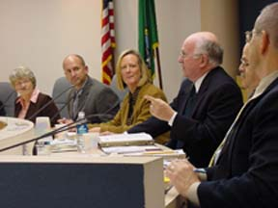

When Does the Open Meetings Act Generally Apply?
Applies to city councils, planning and zoning commissions, boards of adjustment, building & property standards commissions, and Type A or B corporations.
A quorum is present and discusses public business.
Not purely social gatherings or attendance of public officials at conferences or training.

Slide 39
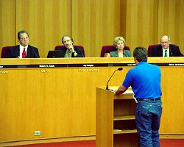
What Right Does the Public Have to Speak on a Particular Agenda Item?
  The Open Meetings Act allows the public to observe the open portion of a meeting
  The Open Meetings Act does not give members of the public a right to speak on items considered at an open meeting
  However, during a public hearing, members of the public must be given a reasonable opportunity to speak.

Slide 40

What if an Unposted Issue is Raised at an Open Meeting?
  You may not deliberate or make any decision regarding the item. You have one of four options:
    1) respond with a statement of specific factual information or recite the governmental body’s existing policy on the issue
    2) direct the person making the inquiry to visit with staff
    3) offer to place the item on the agenda at a future meeting
    4) post the matter as an emergency item if it meets the criteria

Slide 41

Closed or Executive Sessions
Must be properly noticed.
Cite provision of the Act that authorizes closed session.
No vote or other action may be taken in an executive session.
Any final action, decision, or vote must be taken in open session.

Slide 42
When can a Building & Property Standards Commission Hold an Executive Session?
Consultation with an attorney to receive legal advice about:
  pending or contemplated litigation;
  settlement offers; and
  any other matter where the attorney’s duty under the Disciplinary Rules of Professional Conduct conflicts with the Open Meetings Act.

Slide 43

Who is Permitted to Attend an
Executive Session?
The Open Meetings Act does not specify who may or may not attend an executive session.
The governmental body has discretion to determine who may attend executive sessions. However, the governmental body may not admit those whose attendance is contrary to the legal basis for the executive session.
?

Slide 44

Open Meetings Act Training
Each elected or appointed public official of a governmental body shall complete a one (1) to two (2) hour training course on the Open Meetings Act within 90 days after the date the member
  Takes the oath of office or
  Assumes responsibilities as a member of the governmental body.

Slide 45
Criminal & Civil Penalties
Criminal
Deliberately trying to circumvent Act’s requirements:
  Fine between $100 and $500
  County Jail between one month and six months
  Or both fine and jail time
  Unlawful closed meeting – Same penalty
  Civil
  Mandamus

Slide 46

Voidable Action
  Tex. Gov’t Code § 551.141
  An action taken by a governmental body in violation of the Open Meetings Act is voidable.

Slide 47
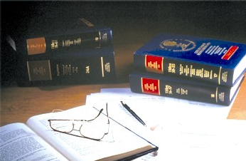
Written Opinions
It is a defense to prosecution of a violation of the Open Meetings Act that a member of a governmental body acted in reasonable reliance on a written opinion of the City Attorney.

Slide 48
REMEMBER --
It is the process of building a consensus or reaching a meeting of the minds that the Open Meetings Act is intended to open to public scrutiny.

Slide 49
Ethical Issues

Slide 50
Conflicts Of Interest
  Local Government Code Chapter 171 (The “Floor”) --
  Cumulative of City Charter and Ordinances
  The official shall file, before
  a vote or decision on any matter. . .
  And shall abstain from further participation in the matter.

Slide 51
The Texas conflict of interest statute addresses two types of conflicts:
Business Entity Conflicts: conflicts due to a City official’s substantial interest in a “business entity” that has an issue before the City; or
Real Property Conflicts: conflicts due to a City official’s substantial interest in “real property” that would be affected by a City action.
If an item is being considered by a City official that does not involve a business entity or real property, then chapter 171 conflict of interest laws would not be applicable.

Slide 52
Whose Interest?
“Local Public Official” includes mayor and councilmembers, P&Z members, Board of Adjustment members, municipal employees
and relatives.

Slide 53
Substantial Interest
Does the official have a “substantial interest” in the business entity or real property?

Slide 54
What is considered a “substantial interest” in a business entity?
There are four ways a person could be deemed to have a “substantial interest” in a business entity.
  Stock Interest: official owns 10 percent or more of the total voting stock
  Other Ownership Interest: official owns 10 percent or more or $15,000 or more of the fair market value of the business entity
  Income Interest: official received 10 percent or more of her gross income for the previous year
  Close Family Member with any of the Above Interests: If a close relative of the Town official has any of the above types of interest in a business entity. Close relatives are those persons within the first degree by consanguinity (blood) or within the first degree by affinity (marriage).

Slide 55
What is considered a “substantial interest” in real property?
A person has a substantial interest in real property if he has:
A $2,500 Ownership Interest in the Real Property: If the official has a $2,500 or more legal or equitable interest in real property that would be affected by the Town action.
A Close Family Member with a $2,500 Ownership Interest in the Real Property: Close relatives are those persons within the first degree by consanguinity (blood) or within the first degree by affinity (marriage).

Slide 56
Application to Relatives
A local public official is considered to have a substantial interest for purposes of Chapter 171 of the Local Government Code “if a person related to the official in the first degree by consanguinity or affinity . . . has a substantial interest under this section [§ 171.002(c)].
Those relationships include the following relatives: parents, children [consanguinity relationships], spouse, spouse of parents or children, spouse’s parents and spouse’s children and stepparents or stepchildren [affinity relationships].
Affinity relationships continue after divorce or death if there is a living child of the marriage. See Tex. Gov’t Code § 573.024(b).

Slide 57
Conflict of Interests: Relatives
Father
Mother
Sons
Daughters
Brothers
Sisters
Spouse
Father-in-law
Mother-in-law
Son-in-law
Daughter-in-law
Brother-in-law
Sister-in-law
Is there a conflict of interest if a City official’s close relative has a substantial interest in a business entity or in real property that is before the City Council, BOA, or P&Z?
Yes, a City official is considered to have the same interest in a business entity or in a piece of real property that his close relatives have in that business entity or real property.

Slide 58
Have a Conflict of Interest
Under Chapter 171? What’s next?
If a city official has a conflict of interest he or she must take three actions:
1) File an Affidavit
2) Abstain from discussion on the Item
3) Abstain from Voting on the Item

Slide 59
Conflicts of Interest
Does the matter before the body “involve” the business entity or real property?
A zoning matter that affects territory in which the member’s residence is located is a matter that involves that real property. DM-130 (1992)

Slide 60
Special Economic Effect
Even so, is it “reasonably foreseeable that an action on the matter will have a special economic effect on the value of the” member’s business entity or real property “that is distinguishable from its effect in the public?”
Fact question for the member.

Slide 61
Conflicts of Interest
If all answers are “yes,” you must file an affidavit and abstain from further participation in the matter.
When? “Before the vote” but best to do it very early since “participation” is prohibited.

Slide 62
Conflicts of Interest
What if I’m not sure?
Particularly given the criminal sanctions, “it might, indeed, be advisable for a member to comply with the affidavit and abstention requirements if he is in doubt whether his failure to do so will place him in violation.” DM-130 (1992)

Slide 63

May a City Official Deliberate About an Issue for Which he has a conflict of interest if he abstains from voting on the issue?
No. A City official may not discuss an issue for which he has a conflict of interest even if he abstains from voting on the item, the City official must file the required affidavit, abstain from discussing the matter, and abstain from voting on the item.

Slide 64
Texas Local Government Code
§ 171.003. PROHIBITED ACTS; PENALTY
(a) A local public official commits an offense if the official knowingly:
  (1) violates Chapter 171
  (2) acts as surety for a business entity that has work, business, or a contract with the governmental entity; or
  (3) acts as surety on any official bond required of an officer of the governmental entity.
(b) An offense under this section is a Class A misdemeanor.

Slide 65
May an applicant’s attorney contact a commissioner to discuss a pending matter before the Building & Property Standards Commission?
No. Rule 4.02 of the Texas Disciplinary Rules of Professional Conduct addresses this issue:
  (a) In representing a client, a lawyer shall not communicate or cause or encourage another to communicate about the subject of the representation with a person, organization or entity of government the lawyer knows to be represented by another lawyer regarding that subject, unless the lawyer has the consent of the other lawyer or is authorized by law to do so.

Slide 66
May an applicant’s attorney contact a commissioner to discuss a pending matter before the Building & Property Standards Commission?
Ethics Opinion 474 (1991): “These provisions of Rule 4.02 prohibit communications by a lawyer for one party concerning the subject of the representation with persons having a managerial responsibility on behalf of the organization that relates to the subject matter of the representation.”

Slide 67
May members of the BPSC go to the site in question, confer with interested parties, meet with neighborhood members, and evaluate the situation outside the public hearing process?
No. Members of the BPSC act in a quasi-judicial capacity—the ex parte receipt of information or opinions is unfair and may deprive an applicant of due process.
Due Process requires : (1) an unbiased decision, (2) adequate notice of the hearing, (3) a hearing in which witnesses are sworn and in which there is an opportunity to present evidence and an opportunity for cross-examination, and (4) a decision based on the record supported by reasons and findings of fact.

Slide 68
Building & Property Standards Commission
June 23, 2016
Presented By:
Alan D. Lathrom
Brown & Hofmeister, L.L.P.
740 E. Campbell Road, Suite 800
Richardson, Texas 75081
(214) 747-6108 FAX (214) 747-6111
alathrom@bhlaw.net

